Slide 1
STAFF PARTY PARTY CELEBRATION

Slide 2
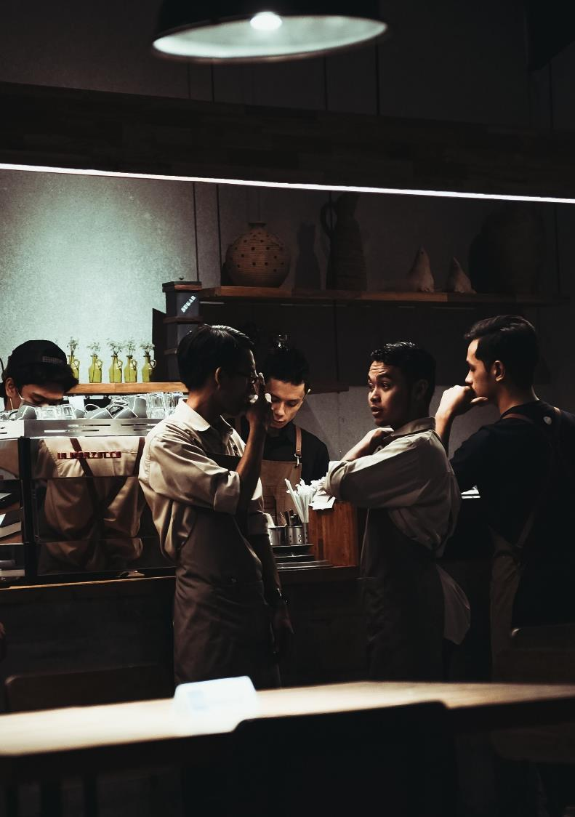
The increase in the age of time that can't be kept gives you maturity;And the only thing that can be left on this warm card, smeared with substandard lines of poetry, bring sinevery my sincere blessing.
Notes:
Lei fengPptNetworkwww.lfppt.com

Slide 3
The increase in the age of time that can't be kept gives you maturity;And the only thing that can be left on this warm card, smeared with substandard lines of poetry, bring sinevery my sincere blessing.
Notes:
Lei fengPptNetworkwww.lfppt.com

Slide 4
The increase in the age of time that can't be kept gives you maturity;And the only thing that can be left on this warm card, smeared with substandard lines of poetry, bring sinevery my sincere blessing.
Notes:
Lei fengPptNetworkwww.lfppt.com

Slide 5
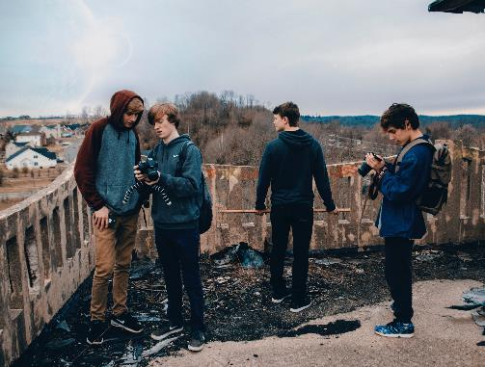
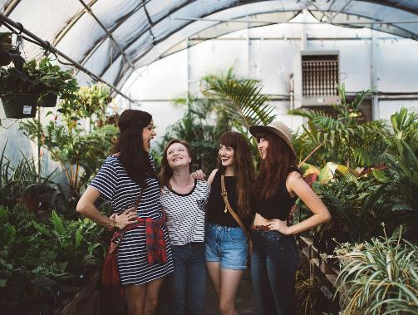
The increase in the age of time that can't be kept gives you maturity;And the only thing that can be left on this warm card, smeared with substandard lines of poetry, bring sinevery my sincere blessing.
Notes:
Lei fengPptNetworkwww.lfppt.com

Slide 6
The increase in the age of time that can't be kept gives you maturity;And the only thing that can be left on this warm card, smeared with substandard lines of poetry, bring sinevery my sincere blessing.
Notes:
Lei fengPptNetworkwww.lfppt.com

Slide 7
The increase in the age of time that can't be kept gives you maturity;And the only thing that can be left on this warm card, smeared with substandard lines of poetry, bring sinevery my sincere blessing.
Notes:
Lei fengPptNetworkwww.lfppt.com

Slide 8
birthday party
The increase in the age of time that can't be kept gives you maturity;And the only thing that can be left on this warm card, smeared with substandard lines of poetry, bring sinevery my sincere blessing.

Slide 9
The increase in the age of time that can't be kept gives you maturity;And the only thing that can be left on this warm card, smeared with substandard lines of poetry, bring sinevery my sincere blessing.
Notes:
Lei fengPptNetworkwww.lfppt.com

Slide 10
The increase in the age of time that can't be kept gives you maturity;And the only thing that can be left on this warm card, smeared with substandard lines of poetry, bring sinevery my sincere blessing.
The increase in the age of time that can't be kept gives you maturity;And the only thing that can be left on this warm card, smeared with substandard lines of poetry, bring sinevery my sincere blessing.

Slide 11
The increase in the age of time that can't be kept gives you maturity;And the only thing that can be left on this warm card, smeared with substandard lines of poetry, bring sinevery my sincere blessing.

Slide 12
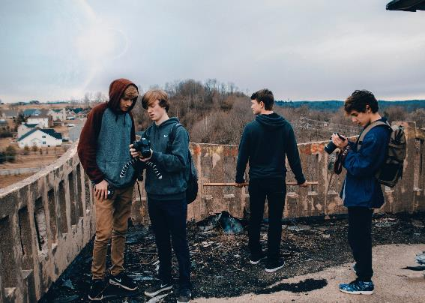
The increase in the age of time that can't be kept gives you maturity;And the only thing that can be left on this warm card, smeared with substandard lines of poetry, bring sinevery my sincere blessing.

Slide 13
birthday party
The increase in the age of time that can't be kept gives you maturity;And the only thing that can be left on this warm card, smeared with substandard lines of poetry, bring sinevery my sincere blessing.

Slide 14
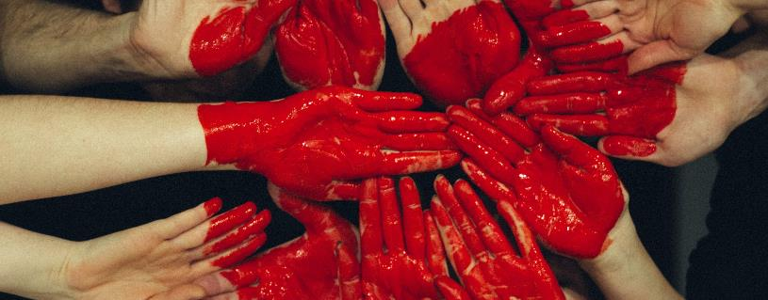
birthday party
The increase in the age of time that can't be kept gives you maturity;And the only thing that can be left on this warm card, smeared with substandard lines of poetry, bring sinevery my sincere blessing.

Slide 15
The increase in the age of time that can't be kept gives you maturity;And the only thing that can be left on this warm card, smeared with substandard lines of poetry, bring sinevery my sincere blessing.

Slide 16
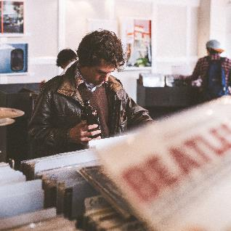
birthday party
The increase in the age of time that can't be kept gives you maturity;And the only thing that can be left on this warm card, smeared with substandard lines of poetry, bring sinevery my sincere blessing.

Slide 17
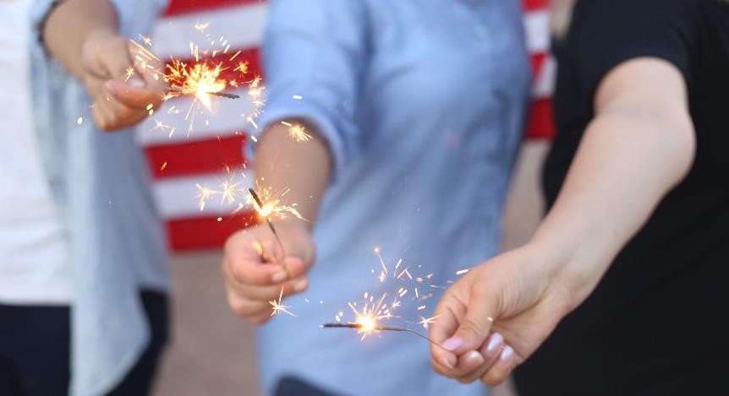
The increase in the age of time that can't be kept gives you maturity;And the only thing that can be left on this warm card, smeared with substandard lines of poetry, bring sinevery my sincere blessing.

Slide 18
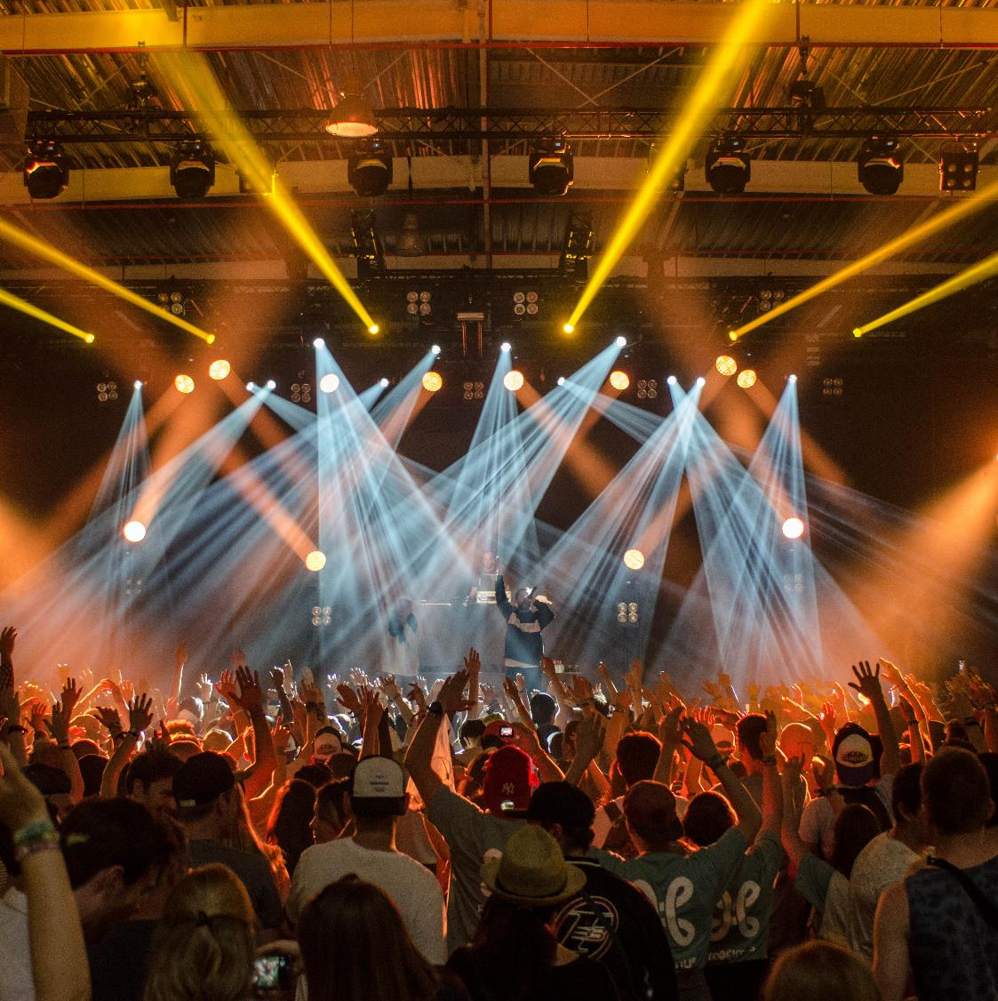
birthday party
The increase in the age of time that can't be kept gives you maturity;And the only thing that can be left on this warm card, smeared with substandard lines of poetry, bring sinevery my sincere blessing.
Notes:
Lei fengPptNetworkwww.lfppt.com

Slide 19
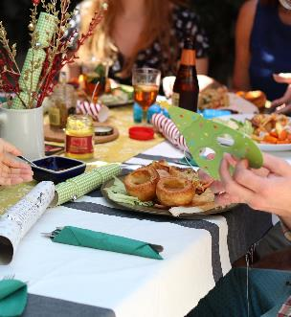
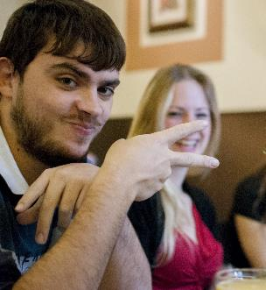
birthday party
000
The increase in the age of time that can't be kept gives you maturity;And the only thing that can be left on this warm card, smeared with substandard lines of poetry, bring sinevery my sincere blessing.

Slide 20
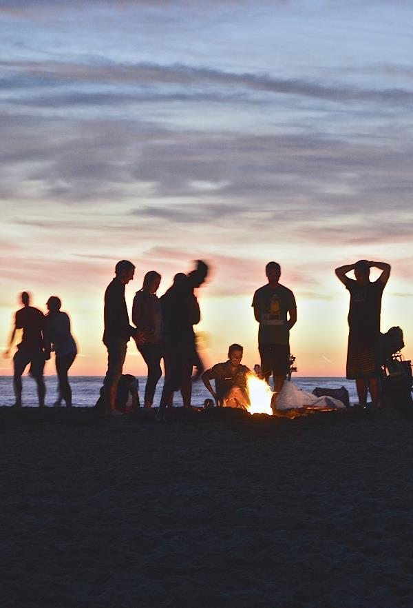
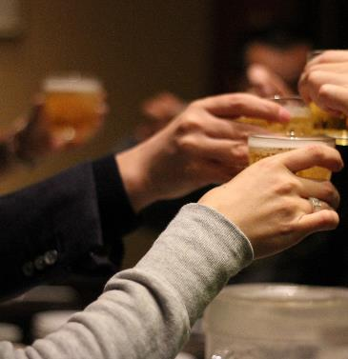
birthday party
The increase in the age of time that can't be kept gives you maturity;And the only thing that can be left on this warm card, smeared with substandard lines of poetry, bring sinevery my sincere blessing.

Slide 21
The increase in the age of time that can't be kept gives you maturity;And the only thing that can be left on this warm card, smeared with substandard lines of poetry, bring sinevery my sincere blessing.
Notes:
Lei fengPptNetworkwww.lfppt.com

Slide 22
The increase in the age of time that can't be kept gives you maturity;And the only thing that can be left on this warm card, smeared with substandard lines of poetry, bring sinevery my sincere blessing.
The increase in the age of time that can't be kept gives you maturity;And the only thing that can be left on this warm card, smeared with substandard lines of poetry, bring sinevery my sincere blessing.
Notes:
Lei fengPptNetworkwww.lfppt.com

