Slide 1
CYBER SECURITY BUSINESS PLAN
Here is where your presentation begins

Slide 2
Business Overview
Management Plan
01
04
Market Analysis
Operating Plan
02
05
Marketing Plan
Financial Plan
03
06
Here you could describe the
topic of the section
Here you could describe the
topic of the section
Here you could describe the
topic of the section
Here you could describe the
topic of the section
Here you could describe the
topic of the section
Here you could describe the
topic of the section

Slide 3
MISSION STATEMENT
Here you could describe the company’s mission. A clear message is a good way to get down to business

Slide 4
OUR COMPANY
SECURITY
COMPANY
Mercury is the closest planet to the Sun and the smallest one in the Solar System—it’s only a bit larger than the Moon

Slide 5
01
BUSINESS OVERVIEW
You could enter a subtitle here if you need it

Slide 6
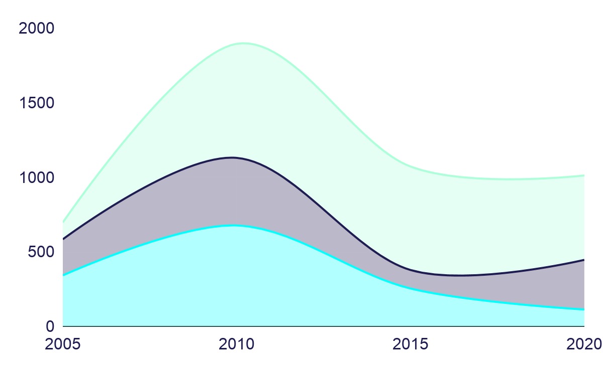
MARKET TRENDS
Edit this!
Mars
Saturn
Venus
To modify this graph, click on it, follow the link, change the data and paste the resulting graph here

Slide 7
PROBLEM VS. SOLUTION
Problem
Solution
Mercury is the closest planet to the Sun and the smallest one in the Solar System—it’s only a bit larger than the Moon
Venus has a beautiful name and is the second planet from the Sun. It’s terribly hot and its atmosphere is poisonous

Slide 8
COMPETITORS
Mars
Jupiter
Saturn
Despite being red, Mars is actually a cold place full of iron oxide
It’s a gas giant and the biggest planet in the Solar System
Saturn is a gas giant, composed mostly of hydrogen and helium

Slide 9
COMPETITIVE ADVANTAGE
Them
Us
Mercury is the closest planet to the Sun and the smallest one in the Solar System
Jupiter is, the biggest planet in the Solar System and the fourth-brightest object in the sky

Slide 10
02
MARKET ANALYSIS
You could enter a subtitle here if you need it

Slide 11
TARGET
$50K - $60K
60%
Women
Average spend per customer
25+ Y/O
25- Y/O
Saturn is a gas giant and has rings
Mercury is the smallest planet in the Solar System

Slide 12
MARKET SIZE
5%
Mercury
Saturn
55%
40%
Mars
Mercury is the smallest planet
It’s a gas giant and has rings
Mars is actually a cold place

Slide 13
MARKET SHARE
Jupiter
Mercury
Venus
Mars
To modify this graph, click on it, follow the link, change the data and paste the new graph here
Jupiter is the biggest planet of them all
Mercury is the closest planet to the Sun
Venus is the second planet from the Sun
Despite being red, Mars is a cold place

Slide 14
COMPETITION ANALYSIS
Jupiter | Mercury | Venus | Mars
Yes | No | Yes | No
Yes | No | Yes | Yes
No | Yes | No | Yes

Slide 15
03
MARKETING PLAN
You could enter a subtitle here if you need it

Slide 16
OUR SERVICES
Mercury
Venus
Mars
Jupiter
Saturn
Neptune
Mercury is the closest planet to the Sun
Venus is the second planet from the Sun
Despite being red, Mars is actually a cold place
It’s the biggest planet in the Solar System
Saturn is composed of hydrogen and helium
Neptune is the farthest planet from the Sun

Slide 17
BREAK-EVEN ANALYSIS
Big Loss
Break-Even Point
High Profit
Loss
Profit
Mercury is the smallest planet
Jupiter is the biggest planet
Earth is where we live on
Mars is actually a cold place
Saturn has several rings

Slide 18
OUR PLANS
BASIC
STANDARD
PREMIUM
$19.99
$25.99
$30.99
Service 1
Service 2
Service 3
Service 1
Service 2
Service 3
Service 1
Service 2
Service 3
START
START
START

Slide 19
SALES AND DISTRIBUTION
Channel 2
Channel 3
Channel 1
Channel 4
Mercury is the smallest planet
Saturn has several rings
Mars is actually a cold place
Earth is where we live on

Slide 20
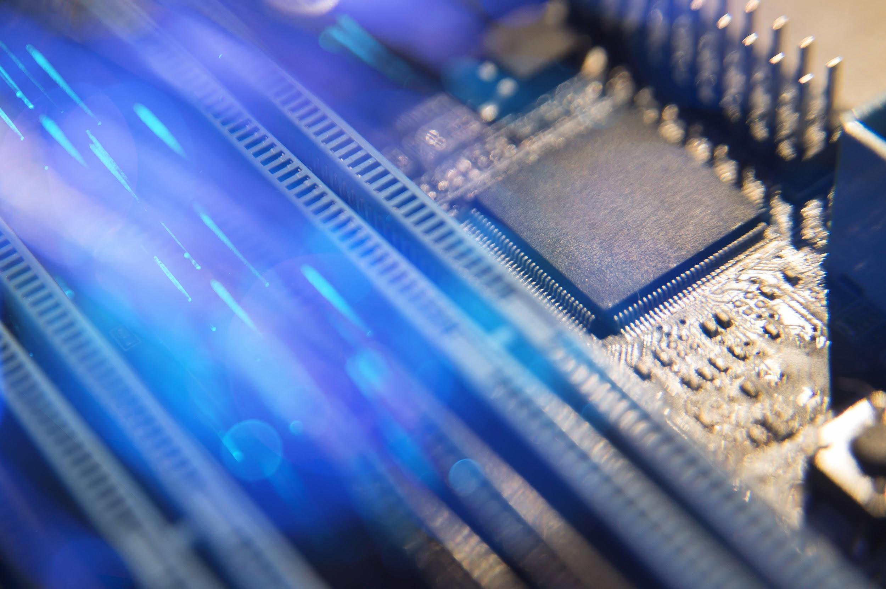
A PICTURE ALWAYS REINFORCES THE CONCEPT
Images reveal large amounts of data, so remember: use an image instead of long texts

Slide 21
ADVERTISING AND PROMOTION
Advertising
PR
Online
Jupiter is a gas giant and the biggest planet in the Solar System
Venus has a beautiful name and is the second planet from the Sun
Despite being red, Mars is actually a cold place full of iron oxide dust

Slide 22
04
MANAGEMENT PLAN
You could enter a subtitle here if you need it

Slide 23
OUR TEAM
Albert Clifford
Joey Patterson
Laura Doe
You can replace the image on the screen with your own
You can replace the image on the screen with your own
You can replace the image on the screen with your own

Slide 24
ORGANIZATIONAL CHART
A
Team 1
IT Department
B
Team 2
CEO
C
Team 3
Marketing Department
D
Team 1

Slide 25
OUR PARTNERS
This is a list of partners
Here you can talk about your partners
Here you can talk about your partners
Here you can talk about your partners
Here you can talk about your partners

Slide 26
OUR EXPANSION
Mercury is the smallest planet
Venus has a beautiful name

Slide 27
05
OPERATING PLAN
You could enter a subtitle here if you need it

Slide 28
OUR PROCESS
Week 2
Week 4
Week 1
Week 3
Mars is actually a cold place
Earth is where we live on
Mercury is the smallest planet
Saturn has several rings

Slide 29
A PICTURE IS WORTH A THOUSAND WORDS

Slide 30
06
FINANCIAL PLAN
You could enter a subtitle here if you need it

Slide 31
PREDICTED GROW
Earth
Mercury
Saturn
Mars
Earth is where we live on
Mercury is the smallest planet
Saturn has several rings
Mars is actually a cold place

Slide 32
BALANCE SHEET
Liabilities
Assets
Equity
1M
700K
What the company owes
300K
What the company owns
Difference between both

Slide 33
498,300,000
Estimated total amount

Slide 34
THANKS!

Slide 35
ALTERNATIVE RESOURCES

