Slide 1
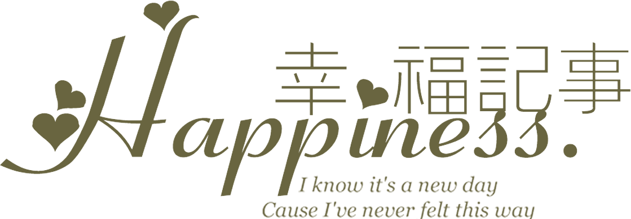
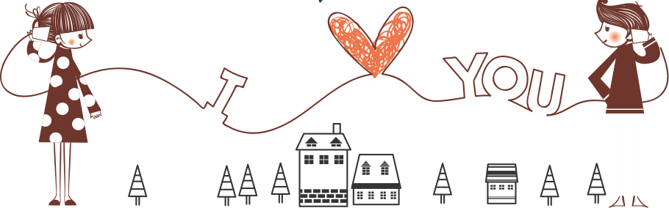

Slide 3
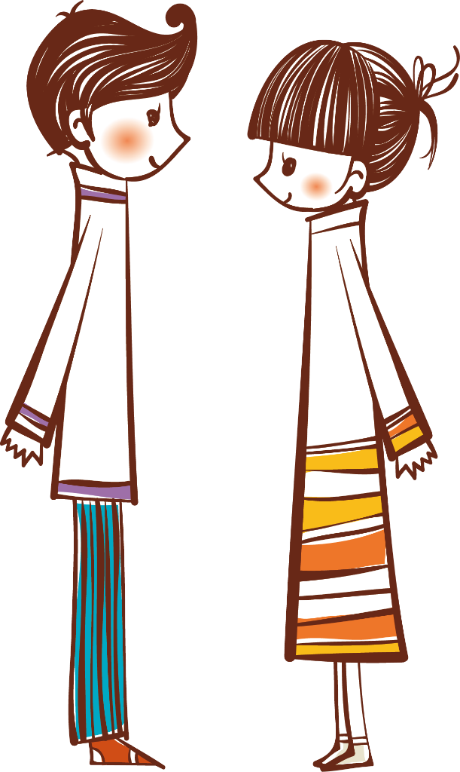
01.Encounters
02.The Story
03.Love
04.Keeping it up
CONTENTS

Slide 4
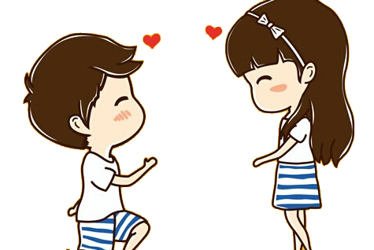
01.Encounters

Slide 5
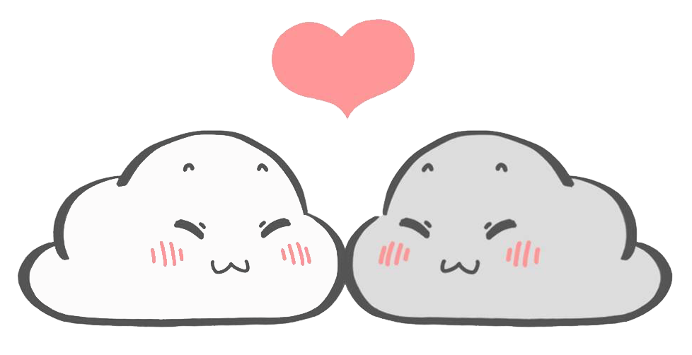
01.Encounters
Love you all the way, miss every step of the way
Ming ming, make me happy countless
Count the years, sweet because of you
Holding hands forever, this life companion

Slide 6
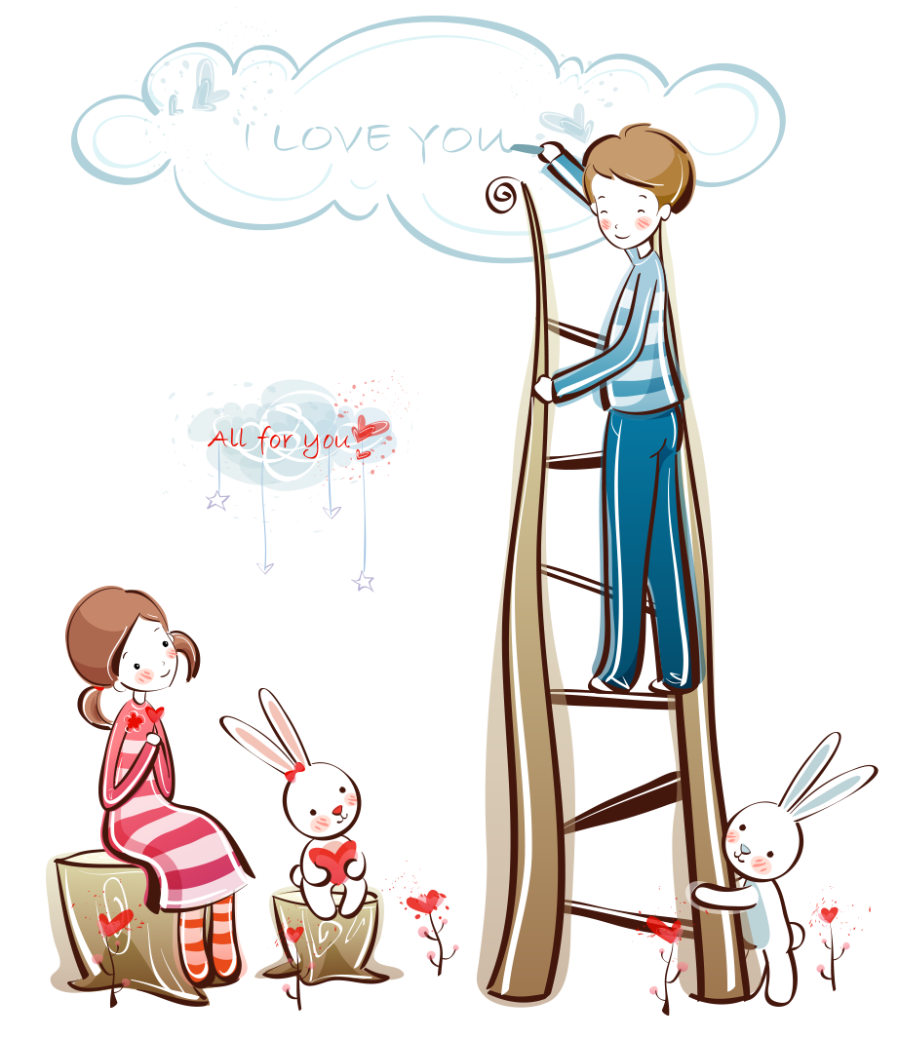
01.Encounters
Love you all the way, miss every step of the way
Ming ming, make me happy countless

Slide 7
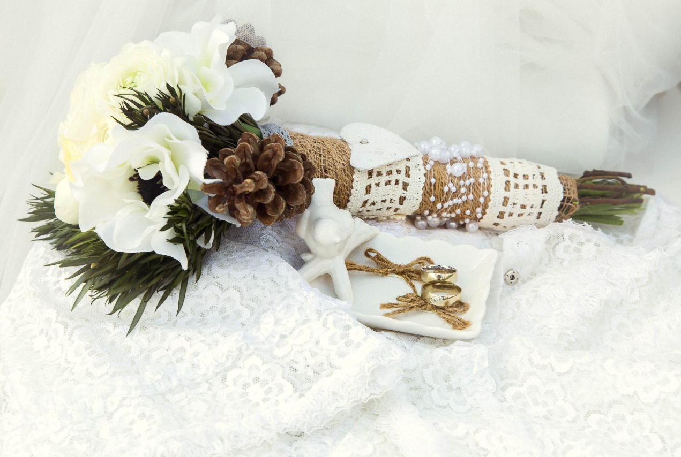
01.Encounters
Love you all the way, miss every step of the way
Ming ming, make me happy countless

Slide 8
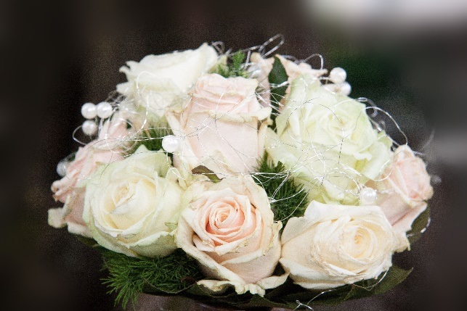
01.Encounters

Slide 9
02.The Story

Slide 10
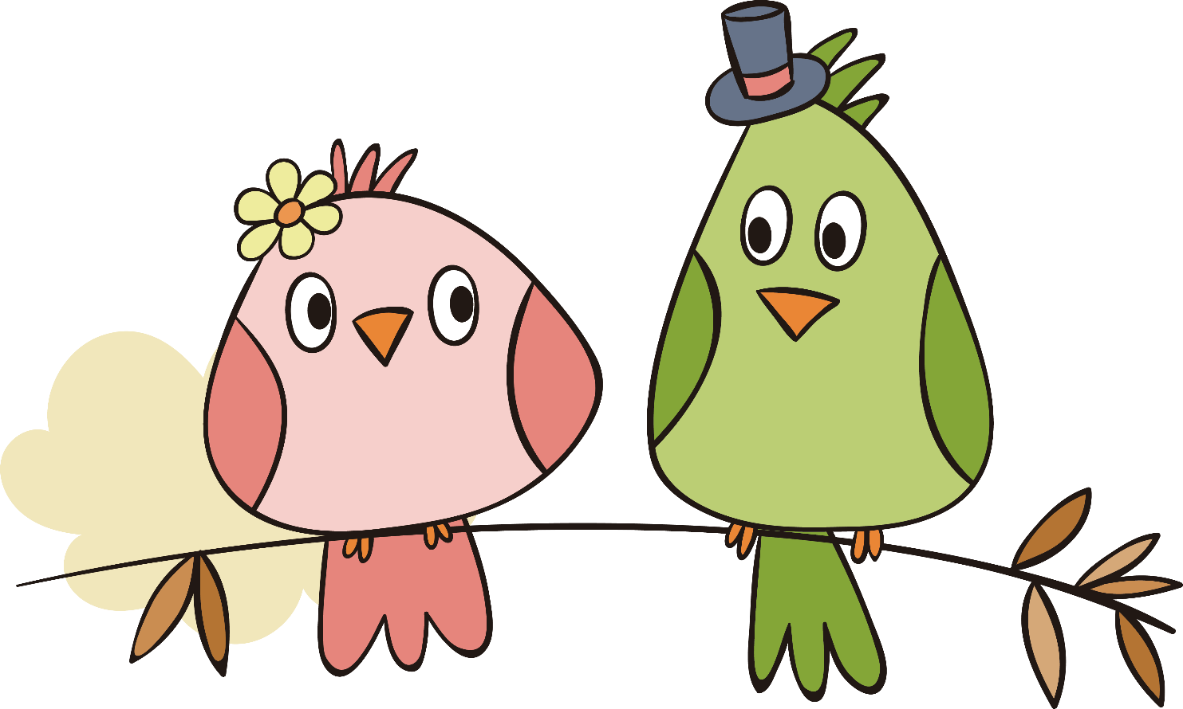
02.The Story of The Story
Love you all the way, miss every step of the way
Ming ming, make me happy countless
Count the years, sweet because of you
Holding hands forever, this life companion

Slide 11
02.The Story of The Story

Slide 12
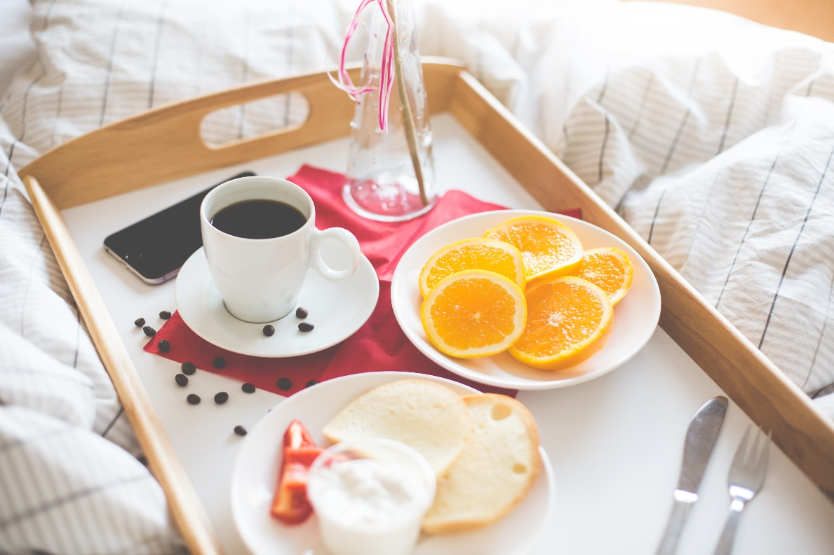
02.The Story of The Story
Love you all the way, miss every step of the way
Ming ming, make me happy countless

Slide 13
02.The Story of The Story
Love you all the way, miss every step of the way
Ming ming, make me happy countless
Love you all the way, miss every step of the way
Ming ming, make me happy countless

Slide 14
03.Love

Slide 15
03.Love
Love you all the way, miss every step of the way
Ming ming, make me happy countless

Slide 16
03.Love
Love you all the way, miss every step of the way
Ming ming, make me happy countless

Slide 17
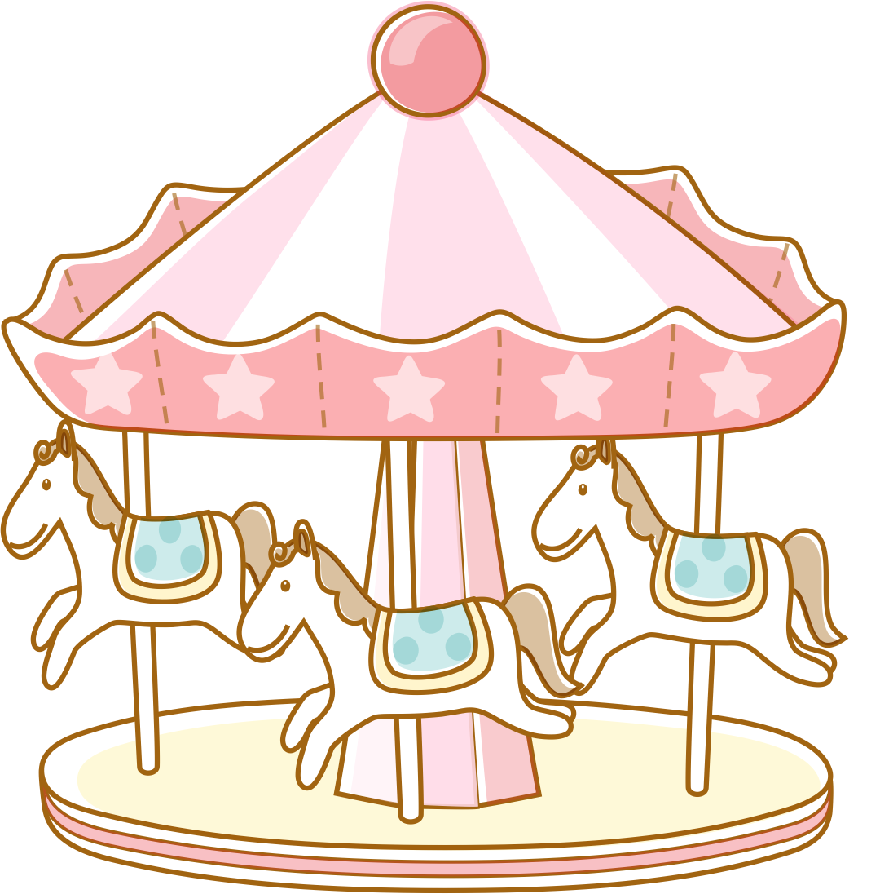
03.Love
Love you all the way, miss every step of the way
Ming ming, make me happy countless
Love you all the way, miss every step of the way
Ming ming, make me happy countless

Slide 18
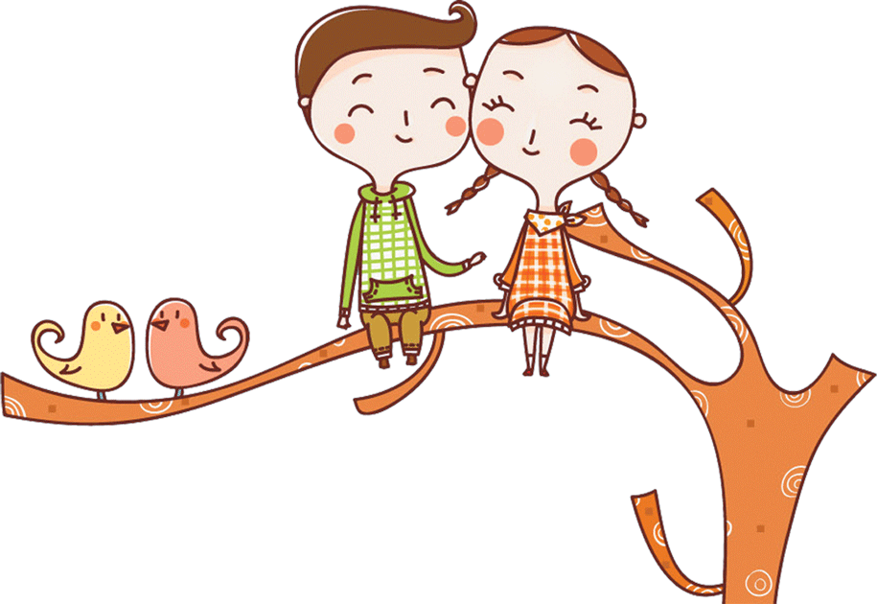
03.Love
Love you all the way, miss every step of the way
Ming ming, make me happy countless

Slide 19
04.Keeping it up

Slide 20
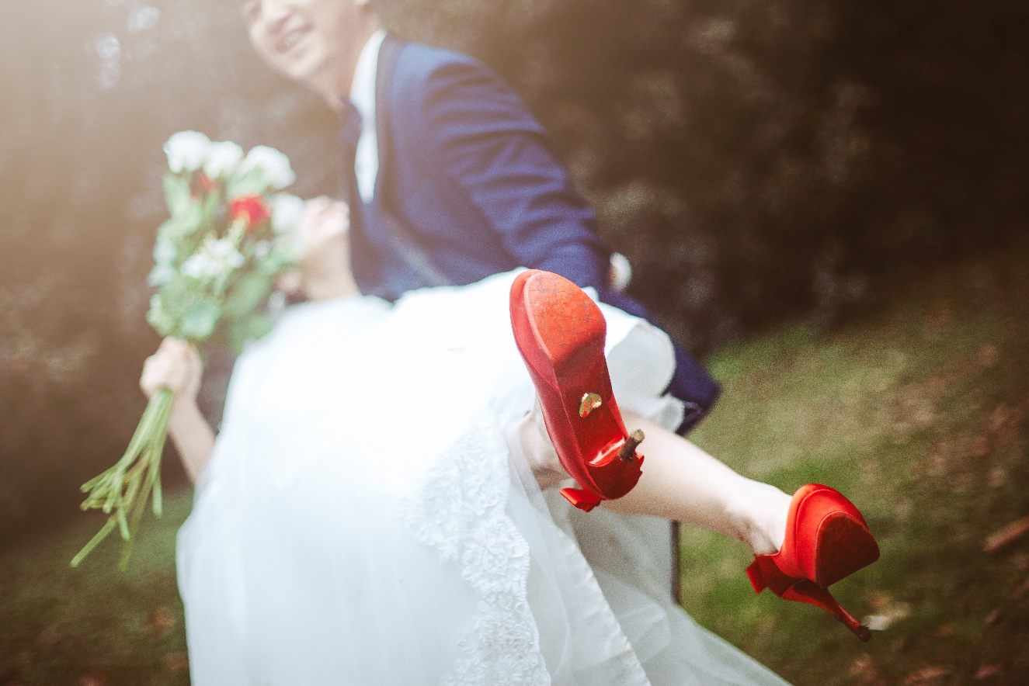
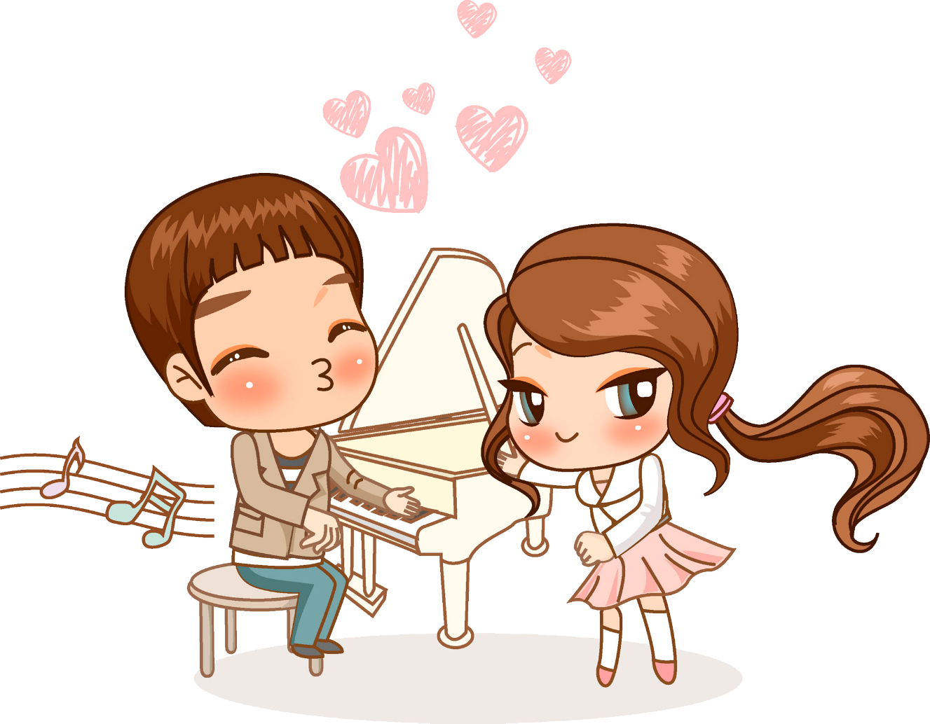
04.Keeping it up

Slide 21
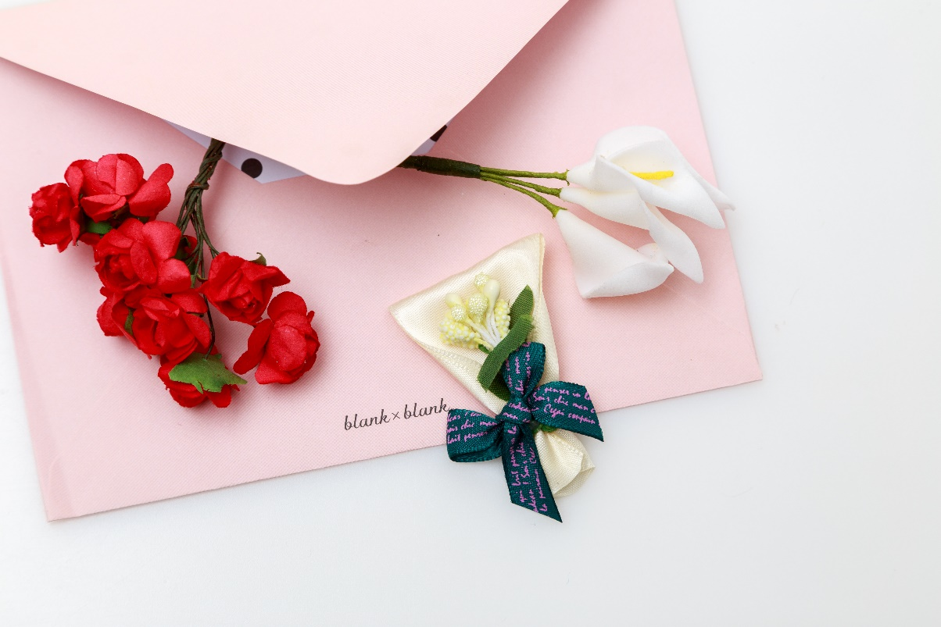
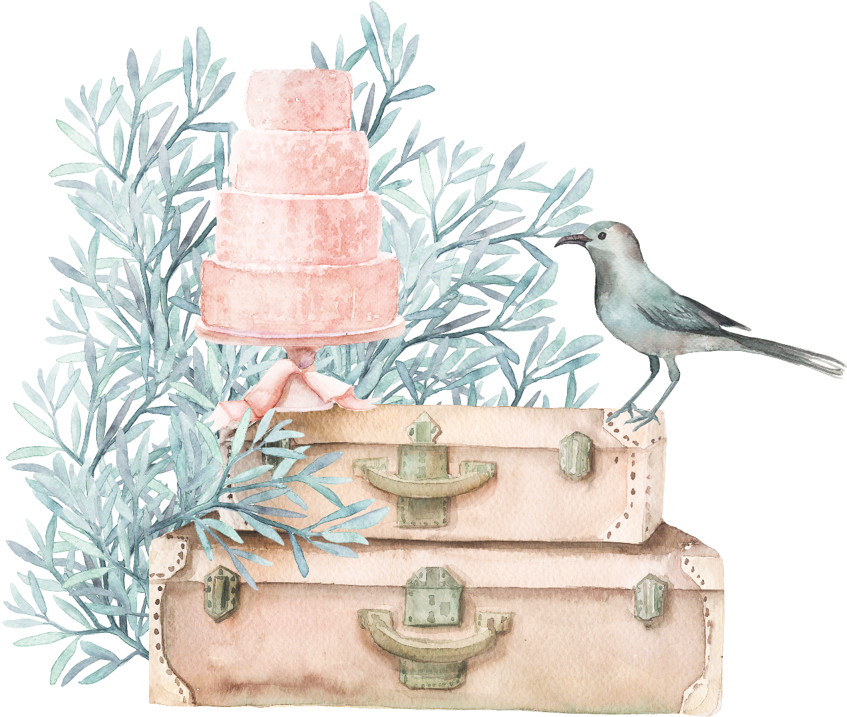
04.Keeping it up
Love you all the way, miss every step of the way
Ming ming, make me happy countless

Slide 22
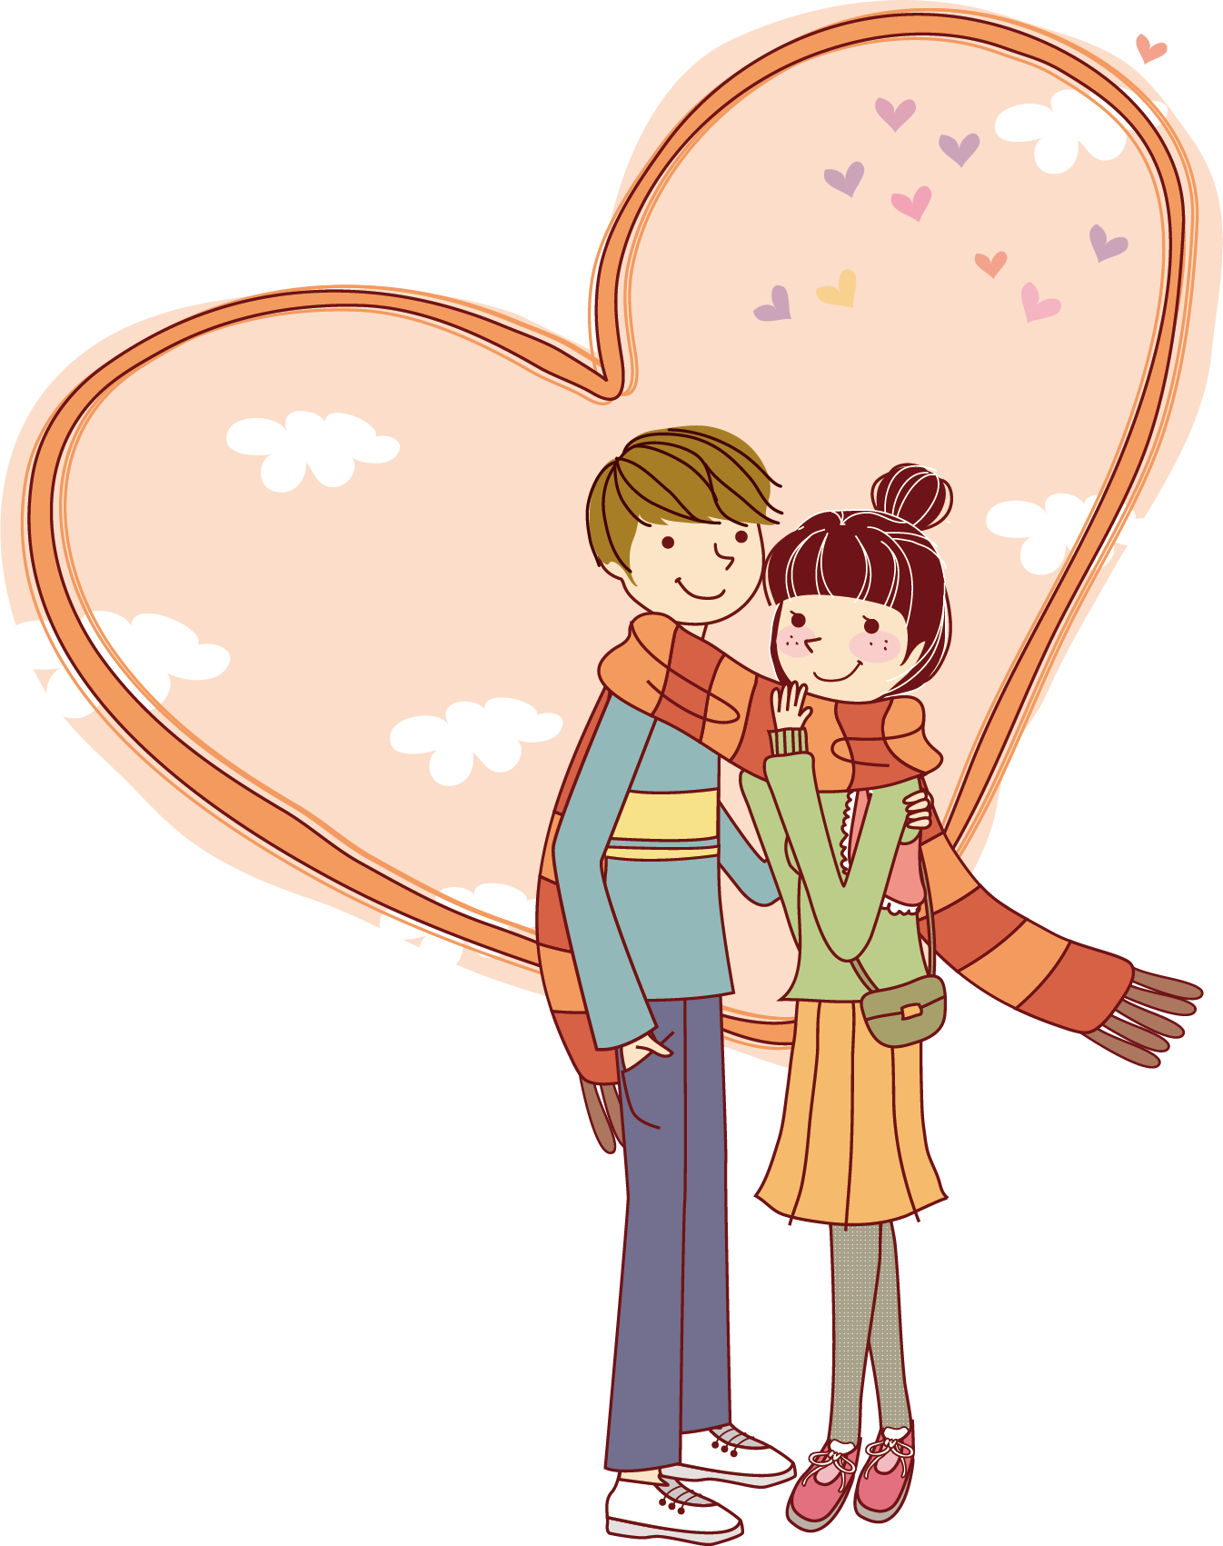
04.Keeping it up
Love you all the way, miss every step of the way
Ming ming, make me happy countless
Count the years, sweet because of you
Holding hands forever, this life companion

Slide 23
04.Keeping it up
Love you all the way, miss every step of the way
Ming ming, make me happy countless
Count the years, sweet because of you
Holding hands forever, this life companion

