Slide 1
LOGO
Company Name
NEW MEDIA
High-end
PPT templates
PLAN
Double-click here to add your text message content Double-click here to add your text message content
Report : www.freeppt7.com Time : 20XX. XX

Slide 2
LOGO
Company Name
01. Tittle text
02. Tittle text
Who we are
What are we going to do
CONTENTS
03. Tittle text
04. Tittle text
What do we do
Our strategic objectives
05. Tittle text
06. Tittle text
Why do we do that?
How much money do we need

Slide 3
LOGO
Company Name
01
Company introduction
Add a detailed text description here, suggesting that it is relevant to the title and consistent with the overall language style, and that the language description be as concise and vivid as possible.
PART ONE

Slide 4
Company introduction
Company profile
01
02
03
Add a detailed text description here, suggesting that it is relevant to the title and consistent with the overall language style
Add a detailed text description here, suggesting that it is relevant to the title and consistent with the overall language style, and that the language description be as concise and vivid as possible.
Add a detailed text description here, suggesting that it is relevant to the title and consistent with the overall language style

Slide 5
Company introduction
Basic company information
Company name:xxxxxx
Studio Name:XXXMedia companies
Corporate legal person:freeppt7.com
address: XXroadXXXedifice747

Slide 6
Company introduction
Team introduction
specialized
young
JOHN：Click here to add content that matches the title.
XXX：Click here to add content that matches the title.
Have a dream
High execution
LISA：Click here to add content that matches the title.
XXX ：Click here to add content that matches the title.

Slide 7
Company introduction
Introduction to the core members
leadership
Organizational ability
Planning ability
Risk control
name
General manager of the company, the project team leader
Click here to add content that matches the title.

Slide 8
Company introduction
Introduction to the core members
name
A full-time lawyer
Responsible for legal counsel, drafting and reviewing contracts and other legal matters
name
Health practitioner
Responsible for video recording of healthy eating programs
name
Good at video editing, picture processing
Responsible for editing videos
name
Broadcast host professional
Responsible for video dubbing and commentary

Slide 9
LOGO
Company Name
An introduction to the project
02
Add a detailed text description here, suggesting that it is relevant to the title and consistent with the overall language style, and that the language description be as concise and vivid as possible.
PART TWO

Slide 10
An introduction to the project
The project topic
Tittle
Tittle
Tittle
Tittle
Tittle
For the various cities along the Silk Road and nearby attractions, dig deep into its historical evolution, human customs, national culture;
Visit intangible cultural heritage heirs and other artisans to demonstrate their traditional skills and help them pass on their skills and cultural heritage;
Find local specialties, record food programs, search for local specialties, open up physical sales product lines.

Slide 11
An introduction to the project
What are we going to do
Demand analysis
Tittle text
Tittle text
Click here to add content that matches the title.
Click here to add content that matches the title.
demand
analyse
Tittle text
Tittle text
Click here to add content that matches the title.
Click here to add content that matches the title.
Tittle text
Tittle text
Click here to add content that matches the title.
Click here to add content that matches the title.

Slide 12
An introduction to the project
The problem that the project solves
Enter the text title here
Click here to add content that matches the title.
Enter the text title here
Click here to add content that matches the title.
Enter the text title here
Click here to add content that matches the title.
Enter the text title here
Click here to add content that matches the title.

Slide 13
LOGO
Company Name
03
Products and operations
Add a detailed text description here, suggesting that it is relevant to the title and consistent with the overall language style, and that the language description be as concise and vivid as possible.
PART THREE

Slide 14
Products and operations
Product overview
01
It's good for people's livelihood
Click here to add content that matches the title.
02
It's good for the brand effect
Click here to add content, content to match the title, you can copy and paste directly, to select useful keyword entry.
Click here to add content that matches the title.
03
There are economic benefits
Click here to add content that matches the title.
It is conducive to enhancing the image of the government
04
Click here to add content that matches the title.

Slide 15
Products and operations
Content delivery channels
01
02
03
04
Today's headlines
Baidu hundred
Penguin
Big Fish
Graphic video live

Slide 16
LOGO
Company Name
04
Development planning
Add a detailed text description here, suggesting that it is relevant to the title and consistent with the overall language style, and that the language description be as concise and vivid as possible.
PART FOUR

Slide 17
Development planning
Industry prospects
Policy support
Click here to add content, content to match the title, you can copy and paste directly, to select useful keyword entry.
Today's headliner【A multi-million dollar plan】【Courtesy program】
Baidu hundred【A hundred-plus plan】
Big Fish【Big Fish Potential Bonus】
Tencent's【10 billion plan】
Trends

Slide 18
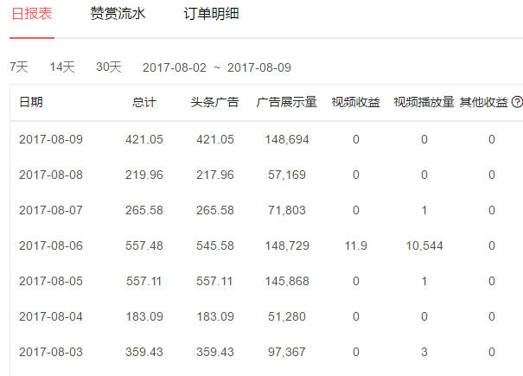
Development planning
Profit analysis——The graphic class
Headlines
Click here to add content, content to match the title, you can copy and paste directly, to select useful keyword entry.
ordinary
Click here to add content, content to match the title, you can copy and paste directly, to select useful keyword entry.
Original
Click here to add content, content to match the title, you can copy and paste directly, to select useful keyword entry.
PPTtemplate http://www.1ppt.com/moban/

Slide 19
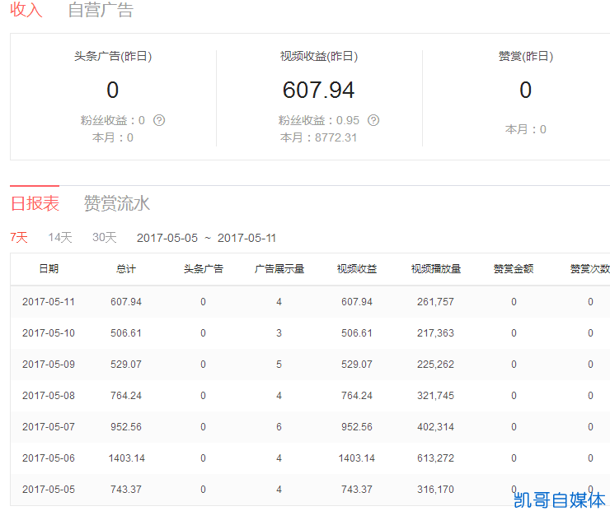
Development planning
Profit analysis——Video class
Headlines
Playback Revenue: Playback is only for video classes
ordinary
Non-original1million playback4About the same
Original
Currently original1million playback12-20About the same

Slide 20
Development planning
Profit analysis——studio
highly efficient
multivariant
Team collaboration, improve work efficiency at the same time improve the quality of content, to achieve the traditional personal self-media and team self-media essential difference.
In the continuous output of tourism programs at the same time to increase low-cost food production columns, to achieve the company's early profit purposes.
specialized
persistent
Content review, video graphic editing more refined, improve the reader's reading experience, increasing the number of fans.
Deepen program content, graft more cultural elements, with different angles of analysis, to achieve a series of self-media content output.

Slide 21
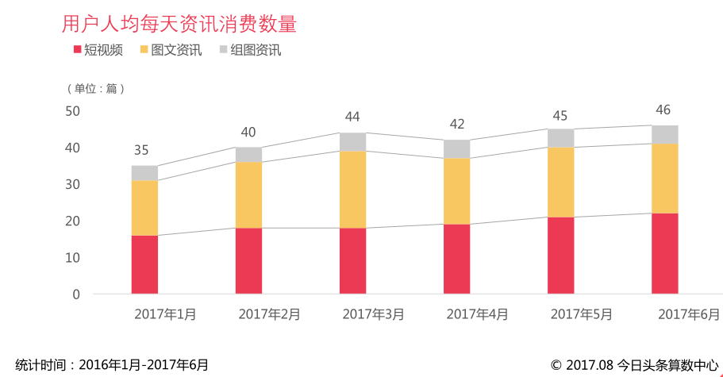
Development planning
Feasibility analysis——User article

Slide 22
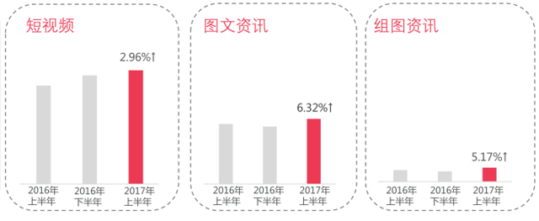
Development planning
Feasibility analysis——
Click here to add content, content to match the title, you can copy and paste directly, to select useful keyword entry.

Slide 23
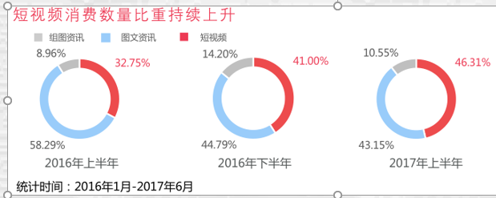
Development planning
Feasibility analysis——Proportion of short video consumption
Compared with graphics, group picture information, video consumption time is longer, the proportion of short video consumption.Rise, pull the average consumption time of information articles accelerated growth.

Slide 24
Development planning
Feasibility analysis——Advertising revenue

Slide 25
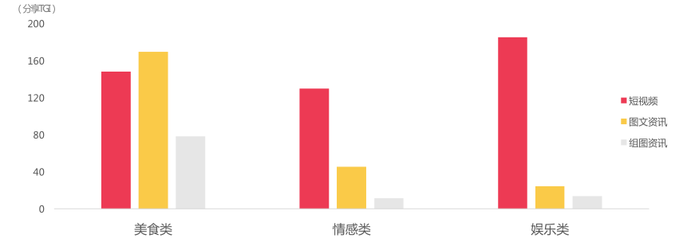
Development planning
Feasibility analysis

Slide 26
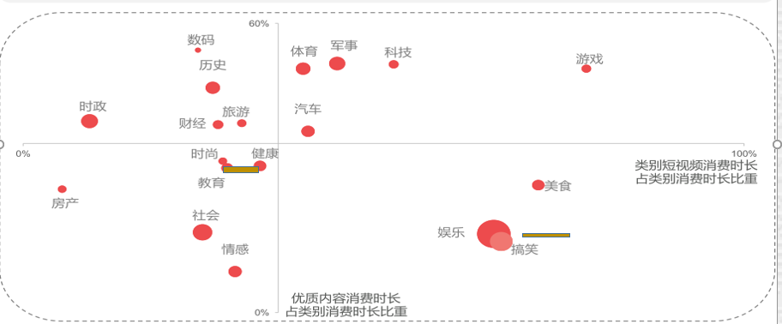
Development planning
Feasibility analysis
The purpose of the map is to observe the performance of different categories in the overall trend of information consumption upgrading.

Slide 27
Development planning
Profit mode
40％
30％
20％
10％
Tittle text
Tittle text
Tittle text
Tittle text
Click here to add content that matches the title.
Click here to add content that matches the title.
Click here to add content that matches the title.
Click here to add content that matches the title.

Slide 28
Development planning
Profit analysis
Fourth quarter
Full-year after-tax income:
Third quarter
Second quarter
First quarter
90%
300ten thousand
80%
60%
General quality from the media account, a platform a year after tax income is probably20wan;
High-quality self-media accounts, a year's after-tax income is probably50-80wan;
30%

Slide 29
LOGO
Company Name
05
Profit analysis
Add a detailed text description here, suggesting that it is relevant to the title and consistent with the overall language style, and that the language description be as concise and vivid as possible.
PART FIVE

Slide 30
Profit analysis
The company's strategic goal
Corporate mission
Win-win cooperation
Explore, discover, share, and pass on
Corporate purpose
Business philosophy
Challenge life and achieve your dreams
Play, feng shui up;
Earn, the pot is full.
Core values
Wind forest volcano

Slide 31
Profit analysis
Short-term goals (2020year)
In-depth travel, food production, discovery and shopping, to ensure high-quality and high-volume content output from the media platform。
First quarter
Third quarter
4from media platforms, with the fewest per platform2The number is too original, released100The above graphics and videos, mainly dunhuang
Take the western section of the Silk Road:
Dunhuang goes west to Xinjiang.
Q2
Fourth quarter
Start walking the eastern part of the Silk Road: Dunhuang departs east to Xi'an.
Organize the Silk Road Travel Strategy.

Slide 32
Profit analysis
Five-year development plan
01
02
Clicks break through
3hundreds of millions
Fans over
100ten thousand
03
04
Footprint coverage
5continent
Make a profit
300ten thousand

Slide 33
LOGO
Company Name
06
Finance and financing
Add a detailed text description here, suggesting that it is relevant to the title and consistent with the overall language style, and that the language description be as concise and vivid as possible.
PART SIX

Slide 34
Finance and financing
Funding gap& Financing purposes
Tittle text
Tittle text
Tittle text
Tittle text
Tittle text

Slide 35
Finance and financing
Core member salaries
posts | expenses | remark
managing director | 8000Yuan | Fees are calculated on a monthly basis
Travel Experiencer | 6000Yuan | Fees are calculated on a monthly basis
Graphic video editing | 5000Yuan | Fees are calculated on a monthly basis
Food-making dietitian | 4000Yuan | Fees are calculated on a monthly basis
Voiceover | 3000Yuan | Fees are calculated on a monthly basis
finance | 2000Yuan | Fees are calculated on a monthly basis
Total expenses:28000/Month12month=336000Yuan

Slide 36
Finance and financing
Travel costs
project | expenses | remark
lodging | 200Yuan | Charges are calculated on a daily basis
dine | 120Yuan | Charges are calculated on a daily basis
Oil charges | 100Yuan | Charges are calculated on a daily basis
Tolls | 100Yuan | Charges are calculated on a daily basis
Scenic tickets | 100Yuan | Charges are calculated on a daily basis
other | 20Yuan | Vehicle maintenance, accidents, etc., by day
Vehicle insurance | 3000Yuan | Fees are calculated on an annual basis
Life insurance policy | 400Yuan | Fees are calculated on an annual basis
Total expenses:640Yuan/Days300sky(Annual travel plan)+3400=195400Yuan

Slide 37
Finance and financing
The cost of making the food
category | expenses | remark
Ingredients | 2000Yuan | Fees are calculated on a monthly basis
ingredient | 1000Yuan | Fees are calculated on a monthly basis
miscellaneous | 800Yuan | Fees are calculated on a monthly basis
Total expenses:3800/Month12month=45600Yuan

Slide 38
Finance and financing
Office expenses
category | expenses | remark
Venue rent | 40000Yuan | Fees are calculated on an annual basis
Site hydropower | 20000Yuan | Fees are calculated on an annual basis
Management fees | 2400Yuan | Fees are calculated on an annual basis
Total expenses:62400Yuan

Slide 39
Finance and financing
Equipment costs
category | expenses | remark
Photography equipment (SLR).+aerial photography+Gopro） | 18000 | Slr5000, aerial photography8000，Gopro5000.
Dashcam | 700 | PRTDT R609
Computer | 8000 | Graphic and video editing, Apple
The recording pen | 1000 | SonyTX650
Total expenses:27700Yuan

Slide 40
Finance and financing
Equity structure&Financing plan

Slide 41
Finance and financing
Profit distribution
At the end of each year, the net profit is withdrawn40%As a current dividend, it is distributed in proportion to the shares held by shareholders.

Slide 42
LOGO
Company Name
PLAN
Thank you！

