Slide 1
FREE PPT TEMPLATES
INTRODUCTION
Insert the Subtitle of Your Presentation
REPORT ：FREEPPT7.COM TIME ：20XX.XX
https://www.freeppt7.com

Slide 2
01.
02.
Title text
Title text
I'm just a sunflower, waiting for belong to me only sunshine.
I'm just a sunflower, waiting for belong to me only sunshine.
CONTENTS
03.
04.
Title text
Title text
I'm just a sunflower, waiting for belong to me only sunshine.
I'm just a sunflower, waiting for belong to me only sunshine.

Slide 3
PART ONE
Title text
We are all too young, a lot of things don't yet know, don't put the wrong loves when gardeners.
The life most of the time, commitments equals to constrain, reluctantly we yearn for bound.

Slide 4
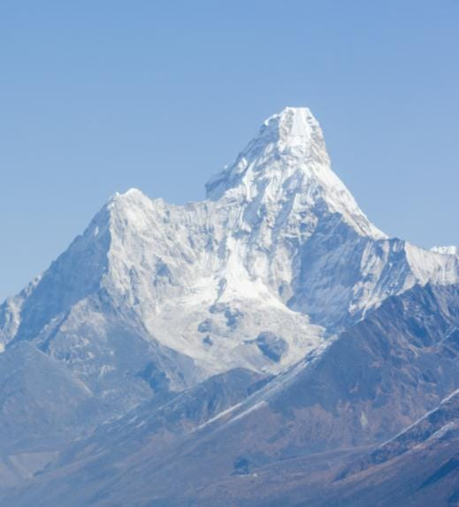
PERSONAL
INTRODUCTION
We are all too young, a lot of things don't yet know, don't put the wrong loves when gardeners.
We are all too young, a lot of things don‘t ye t know, don't put the wrong.
We are all too young, a lot of things don‘t ye t know, don't put the wrong.
We are all too young, a lot of things don‘t ye t know, don't put the wrong.

Slide 5
PERSONAL INTRODUCTION
I'm just a sunflower, waiting for belong to me only sunshine.
20 XX
20 XX
20 XX
20 XX
Title text
Title text
We are all too young, a lot of things don‘t ye t know.
We are all too young, a lot of things don‘t ye t know.
Title text
Title text
We are all too young, a lot of things don‘t ye t know.
We are all too young, a lot of things don‘t ye t know.

Slide 6
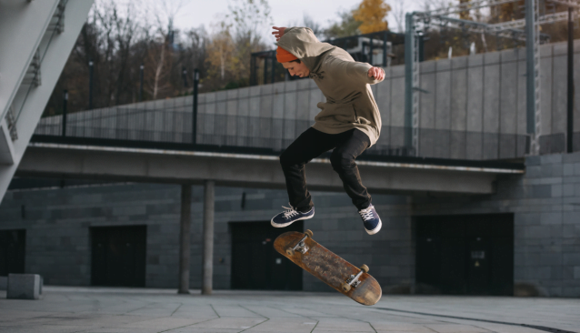
“
PERSONAL
INTRODUCTION
We are all too young, a lot of things don't yet know, don't put the wrong loves when gardeners.
Title text
Title text
We are all too young, a lot of things don‘t ye t know.
We are all too young, a lot of things don‘t ye t know.

Slide 7
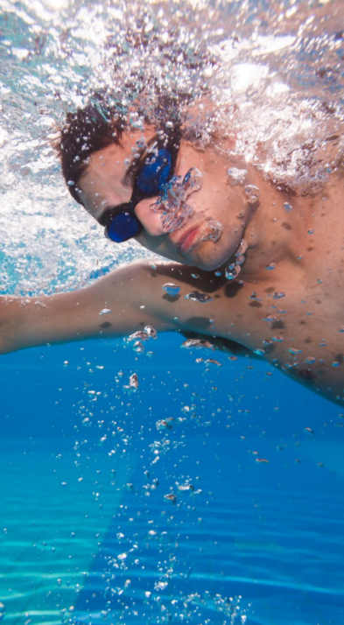
PERSONAL INTRODUCTION
We are all too young, a lot of things don't yet know, don't put the wrong loves when gardeners. I'm just a sunflower, waiting for belong to me only sunshine.
Add title text

Slide 8
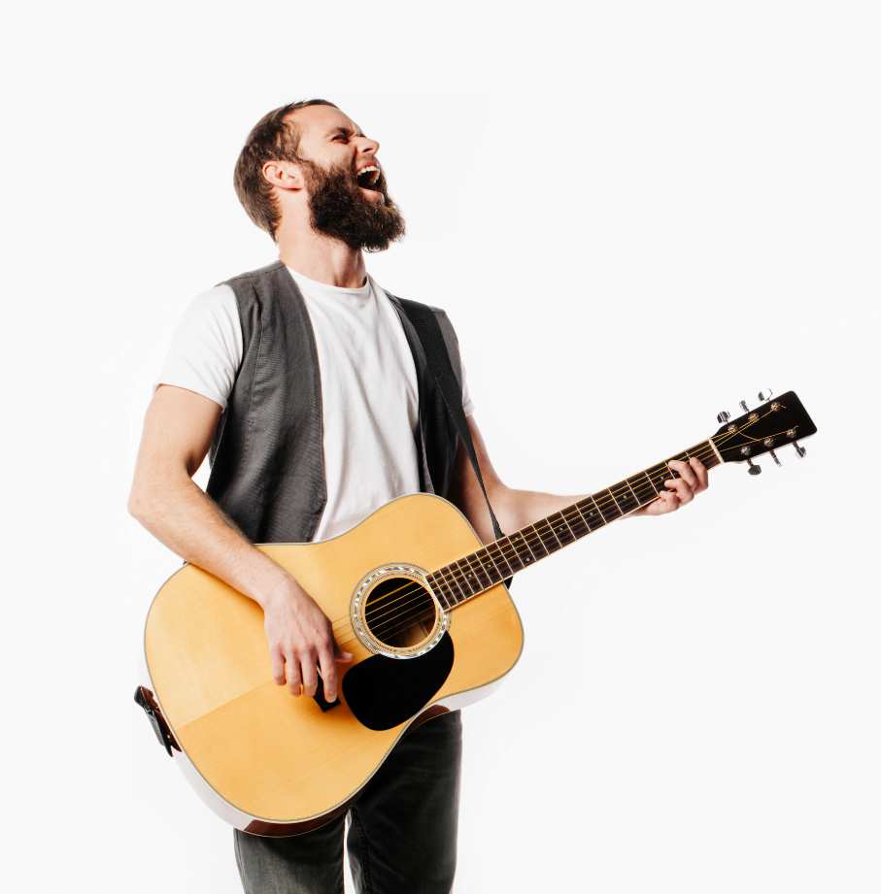
Title text
PART TWO
We are all too young, a lot of things don't yet know, don't put the wrong loves when gardeners.
The life most of the time, commitments equals to constrain, reluctantly we yearn for bound.
MORE

Slide 9
PERSONAL INTRODUCTION
We are all too young, a lot of things don't yet know, don't put the wrong loves when gardeners. I'm just a sunflower, waiting for belong to me only sunshine.
MORE
Add title text

Slide 10
PERSONAL INTRODUCTION
We are all too young, a lot of things don't yet know, don't put the wrong loves when gardeners. I'm just a sunflower, waiting for belong to me only sunshine.

Slide 11
Title text
We are all too young, a lot of things don‘t ye t know, don't put the wrong loves when gardeners.
Title text
Title text
Title text
We are all too young, a lot of things don‘t ye t know, don't put the wrong loves when gardeners.
We are all too young, a lot of things don‘t ye t know, don't put the wrong loves when gardeners.
We are all too young, a lot of things don‘t ye t know, don't put the wrong loves when gardeners.
PPT下载 http://www.1ppt.com/xiazai/

Slide 12
PERSONAL INTRODUCTION
I'm just a sunflower, waiting for belong to me only sunshine.
Title text
We are all too young, a lot of things don‘t ye t know, don't put the wrong loves when gardeners.
Title text
We are all too young, a lot of things don‘t ye t know, don't put the wrong loves when gardeners.

Slide 13
PART THREE
Title text
We are all too young, a lot of things don't yet know, don't put the wrong loves when gardeners.
The life most of the time, commitments equals to constrain, reluctantly we yearn for bound.

Slide 14
PERSONAL INTRODUCTION
We are all too young, a lot of things don't yet know, don't put the wrong loves when gardeners. I'm just a sunflower, waiting for belong to me only sunshine.

Slide 15
PERSONAL INTRODUCTION
02
04
I'm just a sunflower, waiting for belong to me only sunshine.
I'm just a sunflower, waiting for belong to me only sunshine.
01
03
I'm just a sunflower, waiting for belong to me only sunshine.
I'm just a sunflower, waiting for belong to me only sunshine.

Slide 16
Title text
PERSONAL
INTRODUCTION
We are all too young, a lot of things don't yet know, don't put the wrong loves when gardeners.
MORE

Slide 17
PERSONAL INTRODUCTION
I'm just a sunflower, waiting for belong to me only sunshine.
Title text
Title text
We are all too young, a lot of things don‘t ye t know.
We are all too young, a lot of things don‘t ye t know.
Title text
Title text
We are all too young, a lot of things don‘t ye t know.
We are all too young, a lot of things don‘t ye t know.

Slide 18
Title text
PART FOUR
We are all too young, a lot of things don't yet know, don't put the wrong loves when gardeners.
The life most of the time, commitments equals to constrain, reluctantly we yearn for bound.
MORE

Slide 19
PERSONAL INTRODUCTION
01
I'm just a sunflower, waiting for belong to me only sunshine.
02
I'm just a sunflower, waiting for belong to me only sunshine.
We are all too young, a lot of things don't yet know, don't put the wrong loves when gardeners. I'm just a sunflower, waiting for belong to me only sunshine.
03
I'm just a sunflower, waiting for belong to me only sunshine.

Slide 20
Title text
PERSONAL
INTRODUCTION
We are all too young, a lot of things don't yet know.
We are all too young, a lot of things don't yet know, don't put the wrong loves when gardeners. I'm just a sunflower, waiting for belong to me only sunshine.
Title text
We are all too young, a lot of things don't yet know.

Slide 21
PERSONAL INTRODUCTION
We are all too young, a lot of things don't yet know, don't put the wrong loves when gardeners.
Title text
The life most of the time, commitments equals to constrain, reluctantly we yearn for bound.
We are all too young, a lot of things don‘t ye t know, don't put the wrong loves when gardeners.
The life most of the time, commitments equals to constrain, reluctantly we yearn for bound.

Slide 22
PERSONAL INTRODUCTION
Title text
Title text
Title text
We are all too young, a lot of things don‘t ye t know.
We are all too young, a lot of things don‘t ye t know.
We are all too young, a lot of things don‘t ye t know.

Slide 23
PERSONAL
INTRODUCTION
We are all too young, a lot of things don't yet know, don't put the wrong loves when gardeners. I'm just a sunflower, waiting for belong to me only sunshine.

Slide 24
Title text
We are all too young, a lot of things don't yet know, don't put the wrong loves when gardeners.
PERSONAL
INTRODUCTION
Title text
We are all too young, a lot of things don't yet know, don't put the wrong loves when gardeners.
We are all too young, a lot of things don't yet know, don't put the wrong loves when gardeners.
Title text
We are all too young, a lot of things don't yet know, don't put the wrong loves when gardeners.

Slide 25
Thanks
PERSONAL INTRODUCTION
https://www.freeppt7.com

Slide 26
Please follow us for more information:
https://www.jpppt.com/
www.freeppt7.com
Pics: www.Pixabay.com
If you liked the presentation and want to thank, you can follow me on social networks ☺
https://www.instagram.com/slidesfree/
https://www.facebook.com/freeppt7/
https://www.facebook.com/groups/best.PowerPoint.templates
https://www.youtube.com/channel/UCdDW77rhEfG4hzWmlBBnfTQ
https://twitter.com/freeppt7_com

Slide 27
Fully Editable Icon Sets: A

Slide 28
Fully Editable Icon Sets: B

Slide 29
Fully Editable Icon Sets: C

