Slide 1
LOGO
Free
PPT Templates
Insert the Subtitle of Your Presentation
www.freeppt7.com

Slide 2
行业PPT模板http://www.1ppt.com/hangye/
CONTENTS
01
02
03
04
Add title text
Add title text
Add title text
Add title text

Slide 3
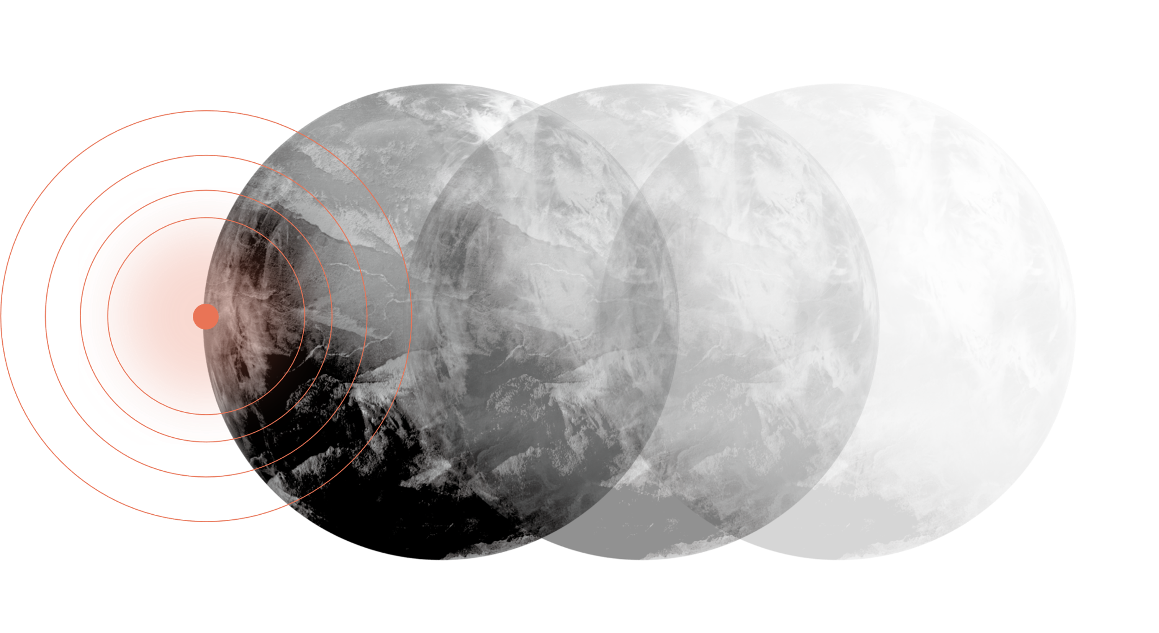
01
Add title text
The life most of the time, commitments equals to constrain, reluctantly we yearn for bound.

Slide 4
01 Add title text
Add title text
BUSINESS PLAN
01
02
03
We are all too young, a lot of things don't yet know, don't put the wrong loves when gardeners.

Slide 5
01 Add title text
Add title text
We are all too young, a lot of things don't yet know, don't put the wrong loves when gardeners.

Slide 6
01 Add title text
Add title text
Add title text
Add title text
Add title text
Gentle to have, but not compromise, I want to be in quiet, not strong.
Gentle to have, but not compromise, I want to be in quiet, not strong.
Gentle to have, but not compromise, I want to be in quiet, not strong.
Gentle to have, but not compromise, I want to be in quiet, not strong.

Slide 7
01 Add title text
Add title text
Would a man running in the rain, also don't want to put into the arms of the false.
Add title text
Would a man running in the rain, also don't want to put into the arms of the false.

Slide 8
02
Add title text
The life most of the time, commitments equals to constrain, reluctantly we yearn for bound.

Slide 9
02 Add title text
KEYWORD
KEYWORD
KEYWORD
KEYWORD
Gentle to have, but not compromise, I want to be in quiet, not strong.
Gentle to have, but not compromise, I want to be in quiet, not strong.
Gentle to have, but not compromise, I want to be in quiet, not strong.
Gentle to have, but not compromise, I want to be in quiet, not strong.

Slide 10
02 Add title text
25%
55%
65%
75%
Add title text
Add title text
Add title text
Add title text
Gentle to have, but not compromise, I want to be in quiet, not strong.
Gentle to have, but not compromise, I want to be in quiet, not strong.
Gentle to have, but not compromise, I want to be in quiet, not strong.
Gentle to have, but not compromise, I want to be in quiet, not strong.
We are all too young, a lot of things don't yet know, don't put the wrong loves when gardeners.

Slide 11
02 Add title text
40%
Gentle to have, but not compromise, I want to be in quiet, not strong.
60%
Gentle to have, but not compromise, I want to be in quiet, not strong.
40%
Gentle to have, but not compromise, I want to be in quiet, not strong.
60%
Gentle to have, but not compromise, I want to be in quiet, not strong.

Slide 12
02 Add title text
Add title text
We are all too young, a lot of things don't yet know, don't put the wrong loves when gardeners.
Gentle to have, but not compromise.
Gentle to have, but not compromise.
Gentle to have, but not compromise.
Gentle to have, but not compromise.
Gentle to have, but not compromise.
Gentle to have, but not compromise.

Slide 13
03
Add title text
The life most of the time, commitments equals to constrain, reluctantly we yearn for bound.

Slide 14
03 Add title text
Add title text
Add title text
We are all too young, a lot of things don't yet know, don't put the wrong loves when gardeners.
We are all too young, a lot of things don't yet know, don't put the wrong loves when gardeners.
Add title text
We are all too young, a lot of things don't yet know, don't put the wrong loves when gardeners.

Slide 15
03 Add title text
Add title text
We are all too young, a lot of things don't yet know, don't put the wrong loves when gardeners.
Add title text
We are all too young, a lot of things don't yet know, don't put the wrong loves when gardeners.
Add title text
We are all too young, a lot of things don't yet know, don't put the wrong loves when gardeners.

Slide 16
03 Add title text
BUSINESS PLAN
Add title text
01
We are all too young, a lot of things don't yet know, don't put the wrong loves when gardeners.
02
Add title text
We are all too young, a lot of things don't yet know, don't put the wrong loves when gardeners.

Slide 17
03 Add title text
65%
90%
40%
75%
Add
title
Add
title
Add
title
Add
title
We are all too young, a lot of things don't yet know, don't put the.
We are all too young, a lot of things don't yet know, don't put the.
We are all too young, a lot of things don't yet know, don't put the.
We are all too young, a lot of things don't yet know, don't put the.
2027
2028
2029
2020

Slide 18
04
Add title text
The life most of the time, commitments equals to constrain, reluctantly we yearn for bound.

Slide 19
04 Add title text
Add title text
We are all too young, a lot of things don't yet know, don't put the wrong loves when gardeners.
125
97
Add title text
We are all too young, a lot of things don't yet know, don't put the wrong loves when gardeners.
55
38
Add title text
We are all too young, a lot of things don't yet know, don't put the wrong loves when gardeners.
18
title
title
title
title
title

Slide 20
04 Add title text
Add title text
202X
We are all too young, a lot of things don't yet know, don't put the wrong.
Add title text
We are all too young, a lot of things don't yet know, don't put the wrong.
202X
Add title text
202X
We are all too young, a lot of things don't yet know, don't put the wrong.

Slide 21
04 Add title text
Add title text
Add title text
Add title text
Add title text
Add title text
Add title text
Add title text
Add title text
We are all too young, a lot of things don't yet know, don't put the.
We are all too young, a lot of things don't yet know, don't put the.
We are all too young, a lot of things don't yet know, don't put the.
We are all too young, a lot of things don't yet know, don't put the.

Slide 22
04 Add title text
Add title text
Add title text
Add title text
We are all too young, a lot of things don't yet know, don't put the.
We are all too young, a lot of things don't yet know, don't put the.
We are all too young, a lot of things don't yet know, don't put the.

Slide 23
04 Add title text
We are all too young, a lot of things don't yet know, don't put the wrong loves when gardeners.
Add title text
Dput the wrong loves when gardeners. We are all too young, a lot of things don't yet know, don't put the wrong loves when gardeners.

Slide 24
04 Add title text
Add title text
Add title text
Add title text
Add title text
We are all too young, a lot of things don't yet know, don't put the.
We are all too young, a lot of things don't yet know, don't put the.
We are all too young, a lot of things don't yet know, don't put the.
We are all too young, a lot of things don't yet know, don't put the.

Slide 25
LOGO
THANKS
www.freeppt7.com

